Slide 1
Project-2 Instagram User Analytics
Project Description :
This Project is an attempt to derive business insights for marketing, product & development teams based on the insights made out of the queries asked by the management team.
The following queries were :
1. People who have been using platform for the longest time ?
2. Who have never posted a single photo on Instagram ?
3. Identify the winner of the contest who has got the most likes for a photo ?
4. Identify the top 5 most commonly used hashtags on the platform ?
5. Which is the best day to launch Ad campaign ?
6. Provide how many times does average user posts on Instagram and the total number of photos on Instagram and total number of users ?
7. Provide data on users (bots) who have liked every single photo on the site.

Slide 2
Approach :
Created a database using MySQL that can store the data and support the queries that needs to be processed for analyzing and loaded the data into the database and used MySQL queries to perform the analysis and made insights about the queries that were asked by the management team.
Tech-Stack Used :
1. MySQL - To run the Query and extract data from database.
2. MS Excel – To Store the Extracted tables from the database.
3. MS PPT – To prepare the report based the insights from the database.
Insights :
The following were the SQL queries and their outputs for the queries that were asked by the management team.

Slide 3
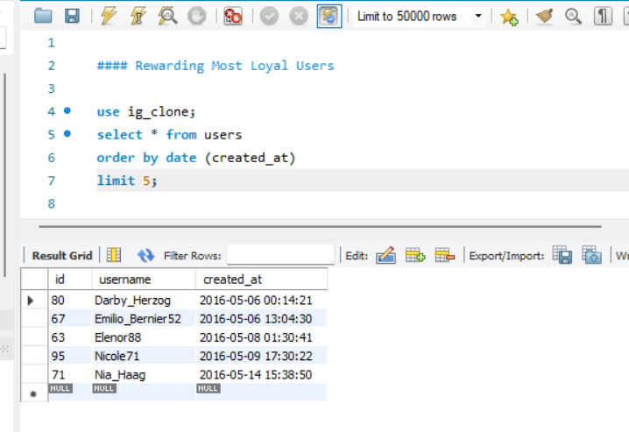
Marketing:
1. Rewarding Most Loyal Users:
They are the 5 oldest users of the Instagram from the database provided.

Slide 4
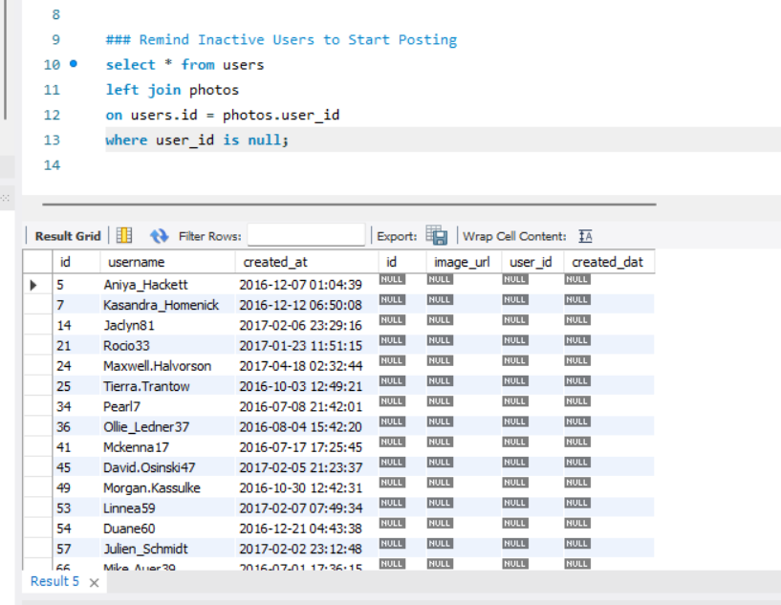
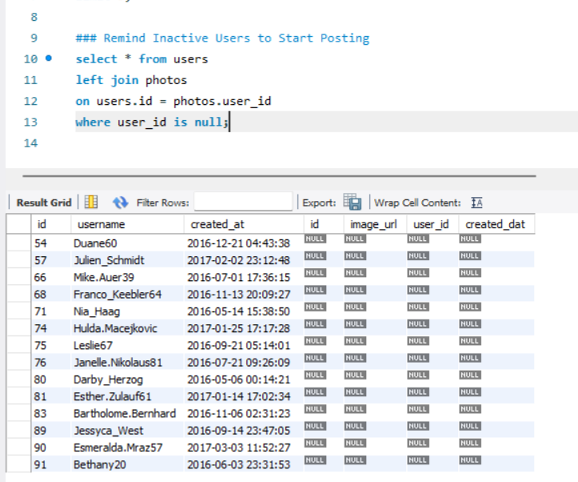
2. Remind Inactive Users to Start Posting:
These are the users who have not yet posted anything on Instagram.

Slide 5
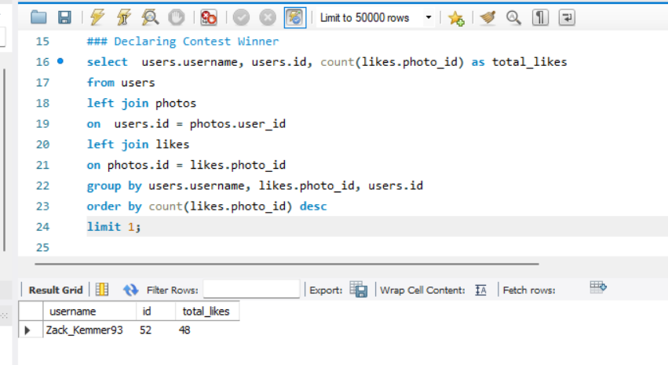
3. Declaring Contest Winner:
Zack_Kemmer93 is the winner with most number of likes for a single photo.

Slide 6
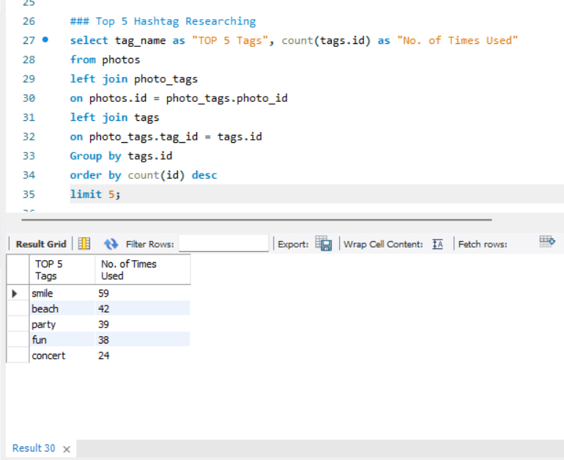
4. Hashtag Researching :
The list of all the hashtags were the most used in Instagram.

Slide 7
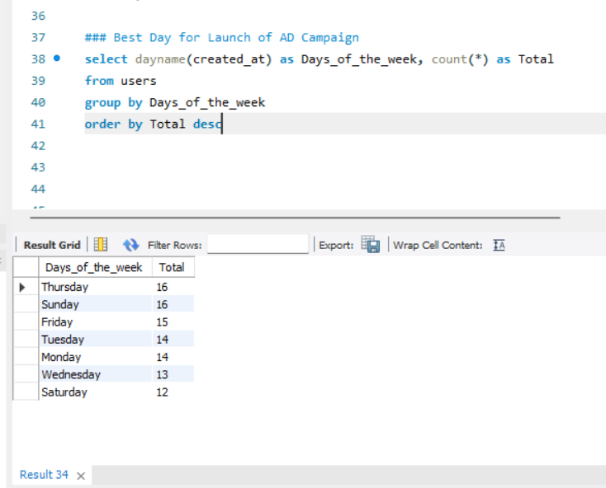
5. Launch AD Campaign :
These days of the week were the most users registered on.

Slide 8
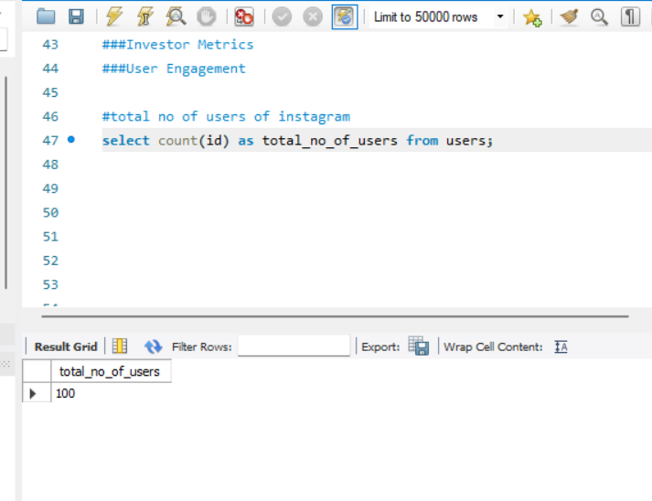
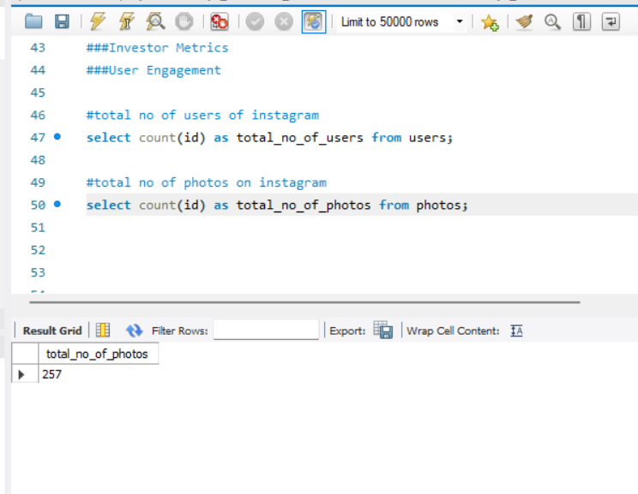
B) Investor Metrics 6. User Engagement:
Total Number Of Users in Instagram
Total Number of Photos in Instagram

Slide 9
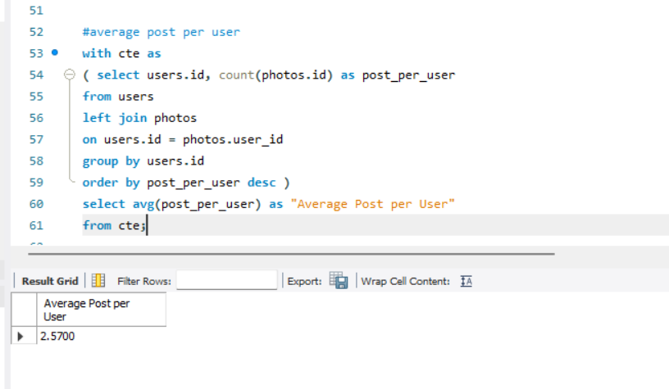
Average Post per User

Slide 10
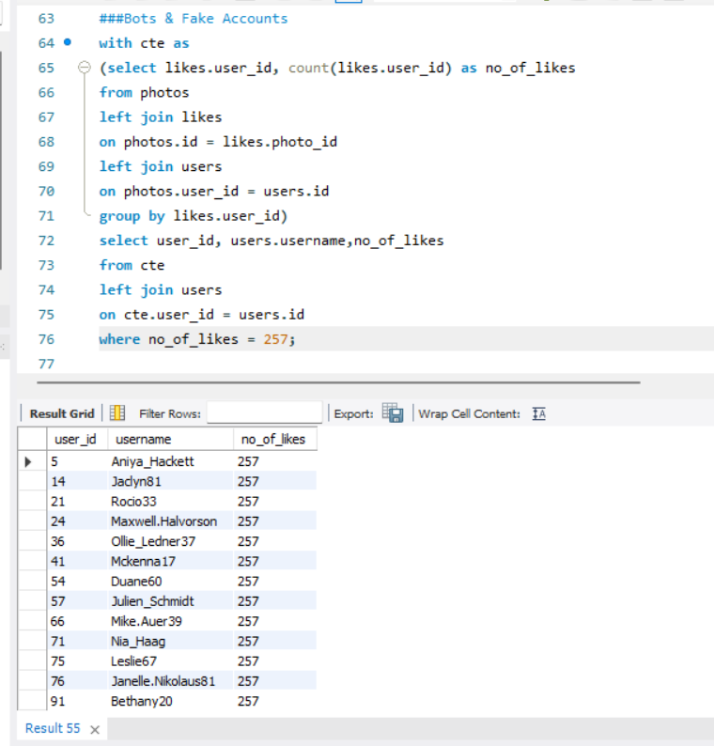
7. Bots & Fake Accounts :
These are the accounts that have liked all the photos that are available, Hence we can conclude that these are bots.

Slide 11
Result :
Analysed many useful insights that could help the business to launch a new marketing campaign, decide on features to build for an app, track the success of the app by measuring user engagement and improve the experience altogether would help the business grow and this would help in making data driven decisions for the business.
It has expanded my knowledge in MySQL and also improved my querying language skills and this project has shown me where do I lag and this will help me to improve in concepts of join.
All the tables and data that were extracted where attached in the following sheet:

